Slide 1
U23 P5

Slide 2
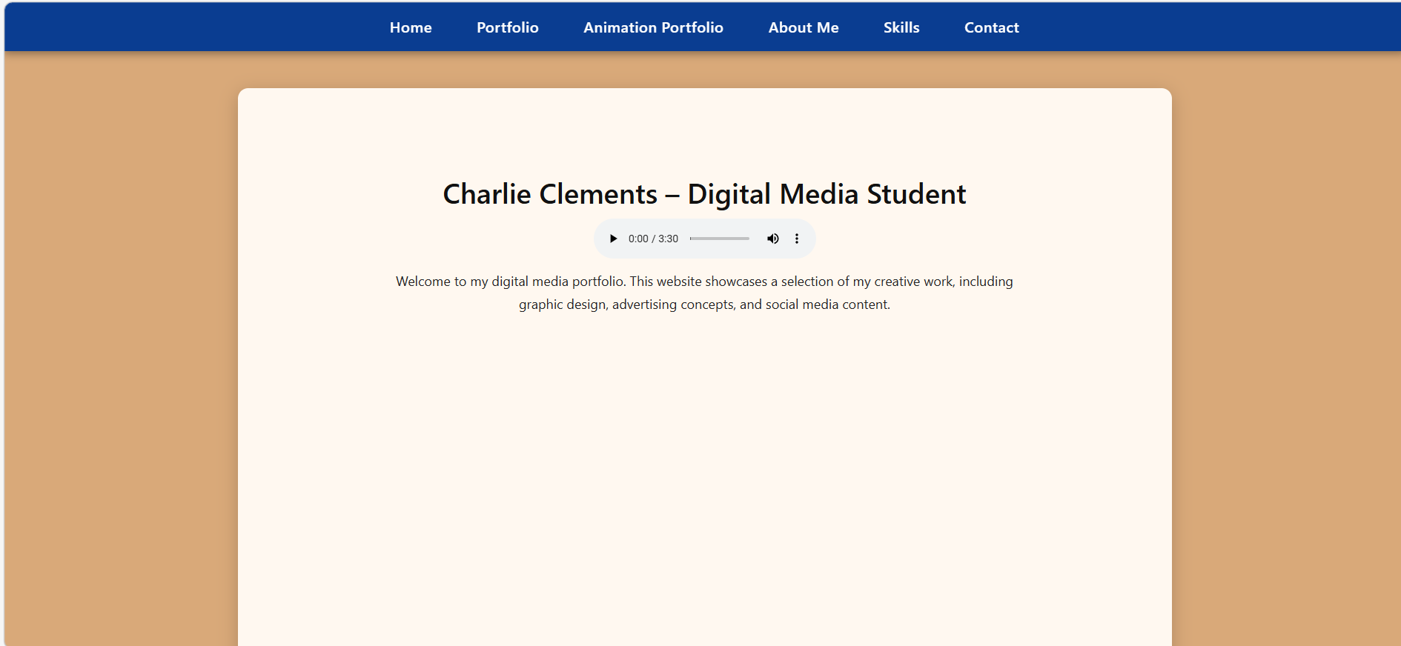

Slide 3
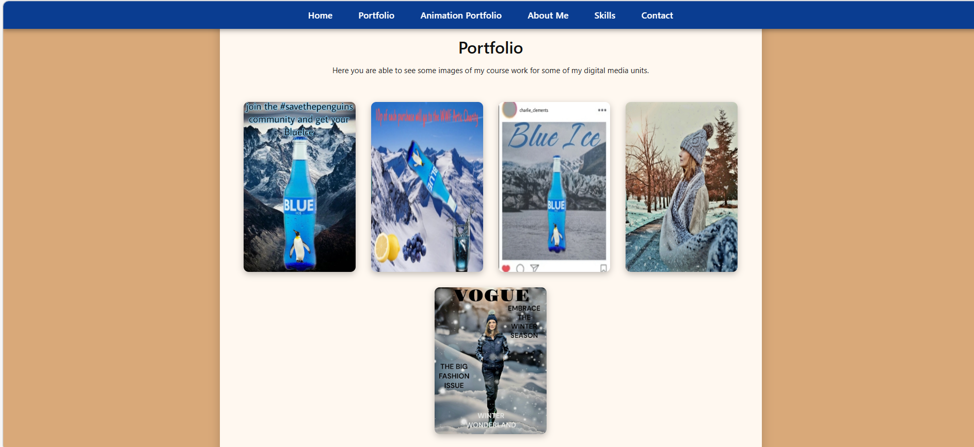

Slide 4
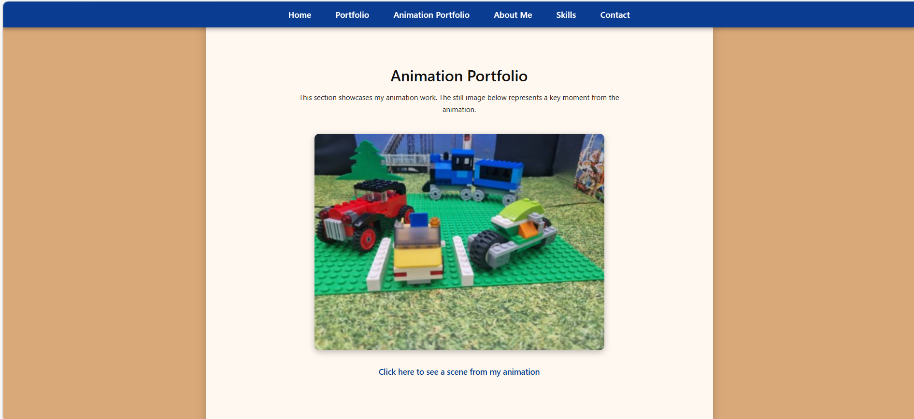

Slide 8
🖼️ 1. Home Page
Screenshot: (insert your screenshot here) Explanation: The Home page introduces who I am and what the website is about. It includes my name, a short welcome message, and an audio player. This page sets the tone for the portfolio and gives visitors an overview of my digital media work.
🖼️ 2. Portfolio Page
Screenshot: (insert your screenshot here) Explanation: The Portfolio page displays examples of my digital media coursework. Each image can be clicked to open a popup with a larger version and a description. This page demonstrates my skills in graphic design, advertising, and photography.
🖼️ 3. Animation Portfolio Page
Screenshot: (insert your screenshot here) Explanation: This page showcases my animation work. It includes a still image from my animation and a link to a YouTube clip. This section highlights my ability to create animated content and shows part of my Unit 10 animation project.
🖼️ 4. About Me Page
Screenshot: (insert your screenshot here) Explanation: The About Me page includes my profile picture and a short paragraph explaining why I chose digital media. It also links to my LinkedIn profile. This page helps visitors learn more about me personally and professionally.
🖼️ 5. Skills Page
Screenshot: (insert your screenshot here) Explanation: The Skills page lists the software and tools I use, such as Photoshop, Canva, and Clipchamp. It explains the areas of digital media I enjoy and what I’m confident working with. This page shows my technical abilities.
🖼️ 6. Contact Page
Screenshot: (insert your screenshot here) Explanation: The Contact page includes a form where visitors can send me a message. It collects their name, email, and message. This page makes the website interactive and allows people to reach out professionally.

